Slide 1
MAY IS BIKE MONTH
Students, families, and faculty – May is Bike Month!
Spring is a perfect time to enjoy this fun activity.
To celebrate Bike Month, students are encouraged to play Bike Bingo
and to ride by school for our official “Bike to School Day” on Wednesday, May 19
Bike Bingo
Bike to School Day
Get a Bingo - Win a Prize!
You can get a Bike Bingo by completing five squares in a row, column, or diagonal line. Try to complete as many as you can!
A completed bingo line or full card will enter you into a raffle for a small prize package.
Bring your card to Bike to School Day to enter, or send to Kelly Mumma 16620 SE 31st Street, Bellevue WA 98008 by June 4th. Be sure to include your name and email address!
Wednesday, May 19
2pm – 4pm
Spiritridge Elementary School
16401 SE 24th St, Bellevue, WA 98008
Ride by the front of the school to say hi and receive a prize!
Bike to School Prizes!
Bike Bingo Prizes!

Slide 2
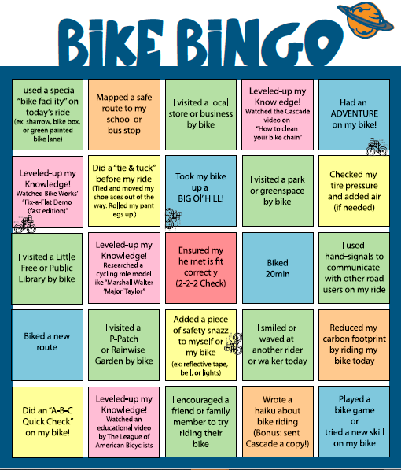
Student name: ___________________
Student or parent email: ___________________
Bike Bingo
RESOURCES for the win:
Watch Cascade’s ‘Bike Helmet Fit Test’ on Instagram TV: https://www.instagram.com/tv/B7E2sLrggbc/
When you’re ready to ride, complete an ABC Quick Check on your bike. Unsure what that is? Watch the tutorial by the League of American Bicyclists: https://bikeleague.org/content/basic-bike-check
Cascade’s Instagram TV Videos https://www.instagram.com/cascadebicycle/channel/
Cascade’s COVID19 Resource Page Information for new riders plus more https://cascade.org/explore/covid-19-resources
Bike Works’ Virtual Community Resources https://bikeworks.org/programs/virtual-communityresources/
The League of American Bicyclists https://bikeleague.org/ridesmartvideos

